Slide 1
Module 22: Understanding Business Objects
Siebel Core Developer and Technology School
Notes:
Time: Lecture: 20 minutes; lab: 10 – 15 minutes
Intent: To explain business objects and links.
Flow: Business objects and links; 1:M and M:M links; and grandchild business components.
Key Terms:
Business object
Link
Parent/child/grandchild views
Please note: Faculty-specific notes are italicized.

Slide 2

Module Objectives
After completing this module you will be able to:
  Describe the role of business objects and links
  Determine the relationship between business components by examining links
Why you need to know:
  Enables you to configure your company’s business logic
Notes:
Each objective and “why you need to know” should be stated aloud.

Slide 3
Business Objects
Are a collection of related business components that represent a major area of the business
  One business component is the parent or master
  Other business components are the children
Provide the foundation for views
Business Object (BO)
Account
Account
Master BC provides focus for BO
Business Component (BC)
Action
Product
Contact
Notes:
This slide is a reminder of what a business object is.
The shaded boxes represent the business components and the lines between the business components represent links. The business object is therefore an object definition that describes a set of business components and how they relate to each other.
The business components that make up the business object are depicted in the UI. Behind every applet is a business component.

Slide 4
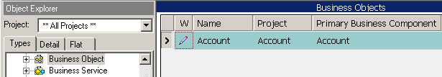
Business Object Definition
Specifies the business object
  Is named for the master business component
Account
Account
Action
Opportunity
Contact
Notes:
This slide shows the object definition that defines a business object. There is a wizard for creating business components, but there is no wizard for creating business objects. You need to create a new record in the list of business object definitions. The Primary Business Component property shows the master or driving business component in the business object. Primary business components only need to be defined when you create an integration object that will be used to transfer data between a Siebel application and an external application.

Slide 5
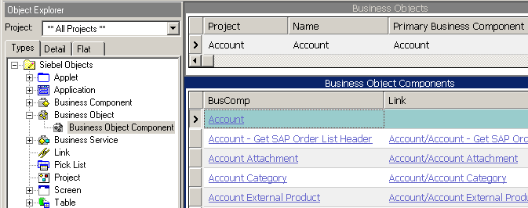
Business Object Component Definition
Specifies that a business component is to be included in the business object
Link property specifies the link definition that relates the parent and child business components
Parent BC
Child BCs
Notes:
This slide shows the object definition that specifies a business component that has been added to the business object. It also includes the link that relates the parent and child business components. If a link is not specified then all the child records will be displayed in the applet.
Once the business object is defined, you then click the Business Object Component child object type in the Object Explorer. You add a record for each business component that belongs to the business object (including the master business component). Each record also includes the link that relates the parent and child business components.

Slide 6
Link Definition
Specifies which records to retrieve from the child business component
  Supports master-detail views
Specifies the foreign keys to populate when new child records are created
Used with both 1:M and M:M relation between parent and child data
Account
Links
Account
Action
Product
Contact
Notes:
This slide explains what a link does. A link also specifies how to populate the foreign keys to relate new records when they are created.
Links are created prior to creating the business object. They are selected from a picklist in the Business Object Component record.

Slide 7
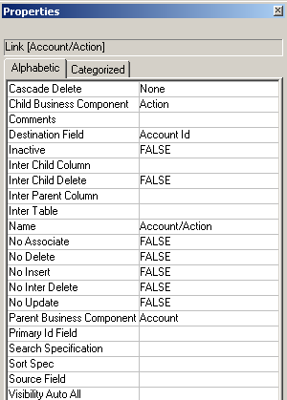
1:M Link
Used for 1:M relationship between
parent and child business
components
  Foreign key (FK) for the
  relationship is in the child table
FK field in child BC
Defaults to parent BC/child BC
PK field in parent BC
(defaults to Id)
Notes:
This slide shows how a 1:M (one-to-many) link is configured. Notice that the destination business component is the right-hand side of the 1:M relationship. This means that the destination field contains a foreign key that refers to the primary key in the source business component. This can be used later when we want to display a parent record and the associated child records. The link is used to locate all records in the child business component that have a value in the FK field that match the value in the parent’s PK field. The child business component is therefore known as the destination, because that is where you need to go to retrieve all the matching records.

Slide 8
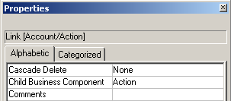
Cascade Delete Property
Specifies whether child records of a 1:M relationship are deleted when the parent record is deleted
  Delete: If a parent record is deleted, all child records are deleted
  Clear: Does not delete, but clears the foreign key column
  None: Neither deletes nor clears the foreign key column
Determined by your business logic
  Should all activities be deleted if parent contact is deleted?
  Should all child opportunities be deleted if the parent account is deleted?
Notes:
The Cascade Delete property in a Link object definition indicates what action to perform on detail business component records of the link if the master record is deleted. The following three values are available for this property:
CLEAR. If Clear is selected, the foreign key reference is removed if the master record is deleted, but the detail records remain in place.
DELETE. If Delete is selected, the detail records are deleted along with the master.
NONE. If None is selected, no operations are performed on the detail record in response to deletion of the master, and the foreign key reference is not removed.
When deciding on what value to place in the cascading delete property, you should review your business logic. For each link specification you will need to decide what action to take if a record is deleted.
The Cascade delete property is relevant for 1:M links only. Cascade Delete is not available for many-to-many links. With a many-to-many link, Siebel applications will automatically delete the intersection record but will leave the child record intact, as it may have other parents.

Slide 9
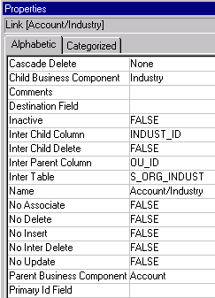
M:M Link
Used for M:M relationship between
parent and child business
components
  Foreign keys for the relationship
  are in the intersection table
Intersection table with FK columns
Notes:
This slide shows how a M:M link is configured. The first step that is required when creating a M:M link is to navigate to the link object type in the object explorers window and select new link. From here you can begin populating the necessary properties in creating your link.
Since there are two foreign keys in the intersection table, and none in the Business Components, we do not specify the source and destination fields. Instead, we specify the name of the intersection table and the columns that hold the foreign keys. We can find which column holds the appropriate foreign key by looking at the Foreign Key Table property of the column (in Table > Column).
The required properties for a M:M link are the Inter Child Column, Inter Child Delete, Inter Parent Column and Inter Table.
The Inter Child Column is the name of the column of the database intersection table that links the intersection table to the Child Business Component. The name is case-sensitive and must be specified the same as it is in the database.
The Inter Child Delete property can have either a True or False value. A True value will delete both the association and the child record when deleted through the child record’s applet, while a False value will delete only the child record’s association. This is specified in M:M links only.
The Inter Parent Column is the name of the column of the database intersection table that links the intersection table to the parent business component. The name is case-sensitive and must be specified the same as it is in the database.
The Inter Table property is the name of the database intersection table. Again, the name is case-sensitive and must be specified the same as it is in the database.
The Name property will need to be populated as well.

Slide 10

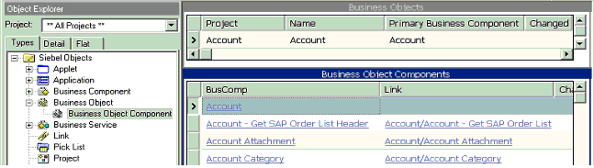
Creating Business Objects
Create a Business Object definition for the new business object
Add the master business component
  Create a Business Object Component definition
  Leave the Link property blank
Add the child business components
  Create the link for the master and child business components
  Create a new Business Object Component definition for the child
  Set the Link property
Return to Knowledge Check
Notes:
Now we will begin reviewing the steps necessary to create a new business object. First, we will describe how to create the business object definition.
In order to create a new business object, the first thing that you will need to do will be to create a business object definition for the new business object.
Navigate to the Business Object Object type in the object explorers window.
Right click on your mouse and select new record.
Populate all the required properties for the business object. These required properties are the Name, the Primary business component, the Project that the business object belongs to.
The next step that you will be required to do is add the master business component.
Specify a master business component in the business object component definition.
This definition should be created in the Business Object Component object type which is a child object type of the business object.
The only required field here is the business component property.
This business component will be the same one specified in the primary business component property of the business object definition.
When specifying the master business component you will need to leave the link property blank.
The final stage in the process will be to add any Child Business Components to the business object.
This should be done in the business object components object type in the same way as the master business component was created.
When creating each entry you will need to populate the name and link properties.
This last major step also applies to adding a new business component to an existing business object.

Slide 11
Modifying Business Objects - Example
Scenario: We were asked to modify the Service Request Business Object, associating a new Business Component, ABC Service Note.
Notes:
In this example, we were asked to modify the Service Request Business Object, associating a new Business Component, ABC Service Note.
We will be creating a new project to add the new business component there, but in real life you will be adding new business components to existing projects too. It will depend of your business requirements.
We will be describing the steps to follow in the coming slides.

Slide 12
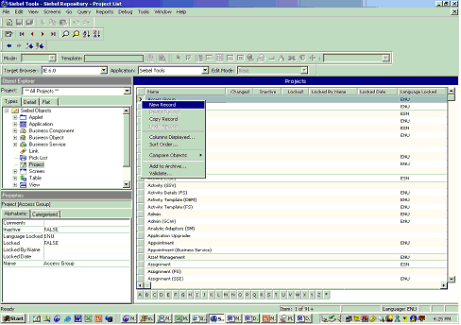
Modifying Business Object - Example
A. Create a new Project
1. In Siebel Tools, go to the Object Explorer and select Projects.
2. Right click on the Projects applet and select New Record.
Notes:
We are creating a new Project for this example, but in real life you can be asked to work in an existing business component. In that case you will have an existing Project and you can skip Part A and B.

Slide 13
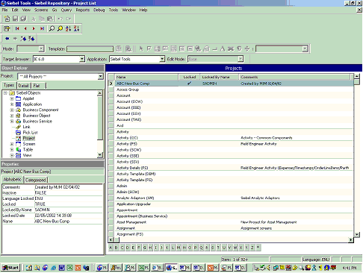
Modifying Business Object - Example
Set the following properties:
  Name: ABC New Bus Comps
  Locked: TRUE
  Comments: Created by ”your initials” on “Today’s Date”
Notes:
A new project has been created.

Slide 14
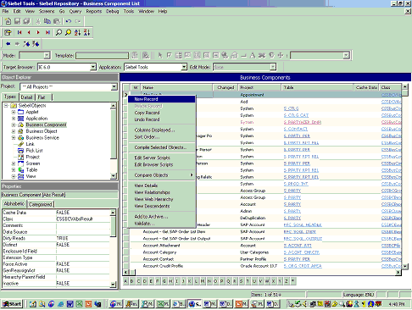
Modifying Business Object - Example
Create a new Business Component.
1. Go to the Object Explorer and select Business Component.
2. Right click on the Business Component Applet and select New Record.

Slide 15
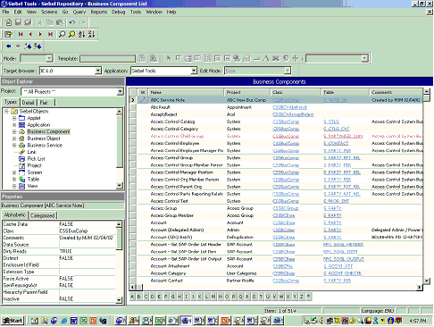
Modifying Business Object - Example
Set the following properties:
Name: ABC Service Note Project: ABC New Bus Comps
Class: CSSBusComp Table: S_NOTE_SR
Comments: Created by ”your initials” on “Today’s Date”
Notes:
A new Business Component has been created.

Slide 16
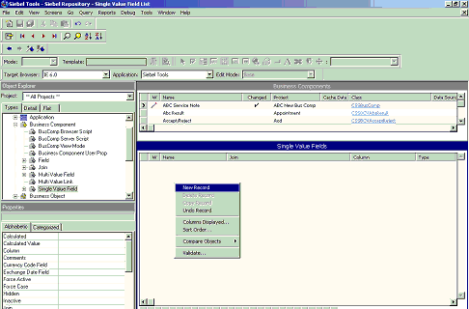
Modifying Business Object - Example
Go to the Object Explorer and select Business Component. Make a query by ABC New Bus Comps. Expand Business Component and select Single Value Field.
Right click on the Single Value Field Applet.

Slide 17
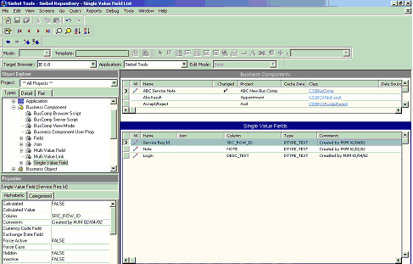
Modifying Business Object - Example
Set the following properties:
Name: Login Column: DESC_TEXT
Type: DTYPE_TEXT
Comments: Created by ”your initials” on “Today’s Date”
Notes:
Also we have added two more records: Service Request Id and Note. Properties for these two fields are displayed in the screen shot.

Slide 18
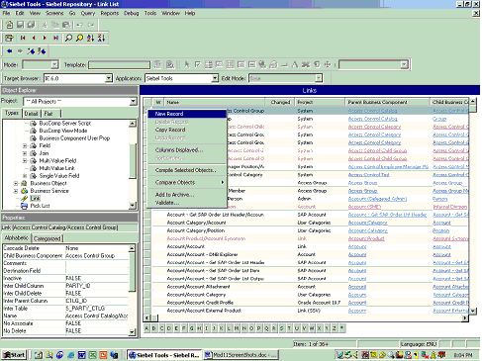
Modifying Business Object - Example
Create a Link.
1. In the Object Explorer select the Link Definition.
2. Right click on the Link applet and select a New Record.

Slide 19
Modifying Business Object - Example
Create a Link.
1. In the Object Explorer select the Link Definition.
2. Right click on the Link applet and select a New Record.

Slide 20
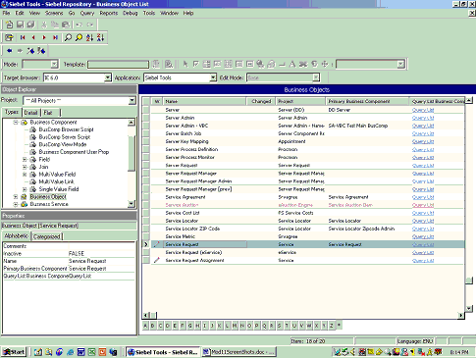
Modifying Business Object - Example
Add the New Business Component to the Service Request Business Object.
1. In the Object Explorer, select the Business Object definition.
2. In the Business Object applet, make a Query by Service Request.

Slide 21
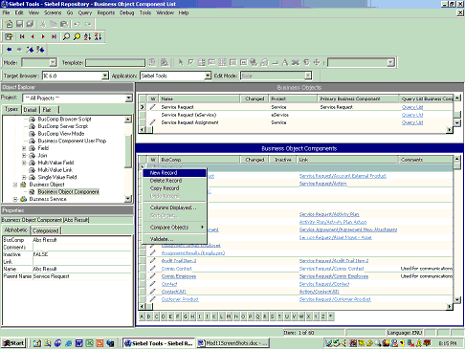
Modifying Business Object - Example
In the Object Explorer, expand the Business Object definition and select Business Object Components.
Right click on the Business Object Component applet and select New.

Slide 22
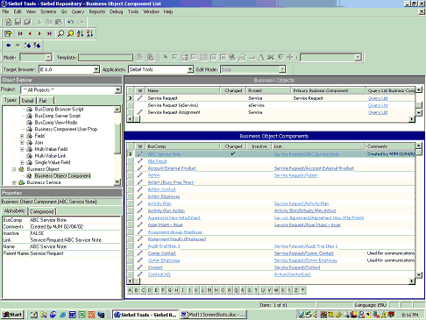
Modifying Business Object - Example
Set the following properties:
BusComp: ABC Service Note
Link: Service Request/ABC Service Note
Notes:
The new business component has been added to the Service Request Business Object.
In this case is not necessary to compile because all this configuration has been done on the Business Object Layer not in the User Interface. Therefore nothing will be visible in the Siebel Application.

Slide 23
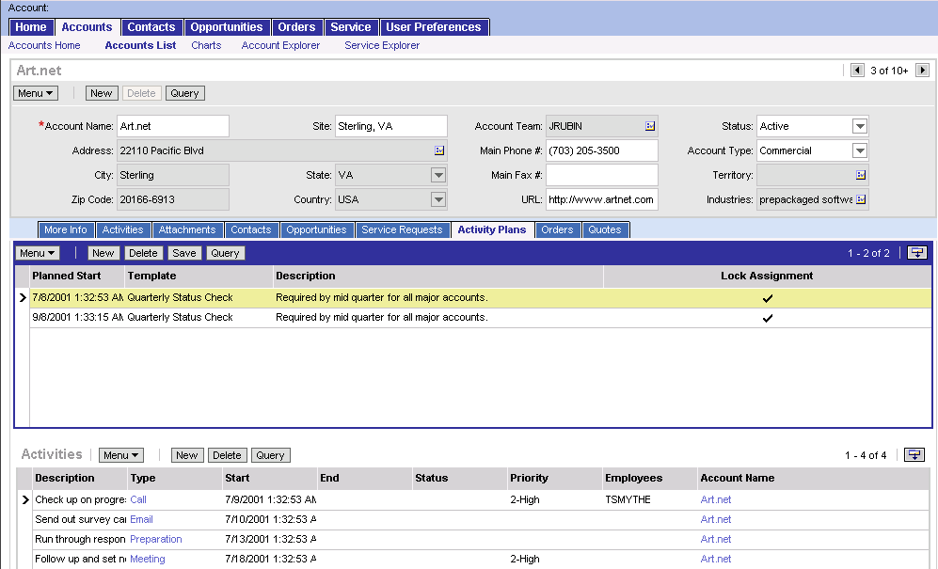
Grandchild Business Components
Business objects may include grandchild business components
Used in parent-child-grandchild views
Activity Plan BC
Activity Plan Action BC
Child activities for selected activity plan
Notes:
It is possible to have more than one generation of records displayed in a Siebel view. In the example shown, an account has one or more activity plans and each activity plan has one or more of its own activities.

Slide 24
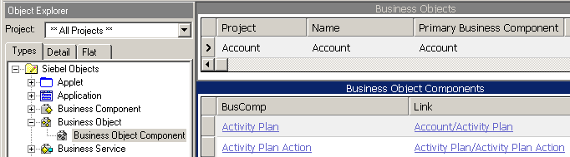
Links for Grandchild Data
Specify how the grandchild and child business component are related
  Used to retrieve grandchild records on parent-child-grandchild views
Parent/child/grandchild
Child BC
Notes:
The picture displayed on this slide describes how the links are set to bring grandchild business components into a business object. Here a link has been created using a business component that is already a child business component of the business object.
By creating a new business object component that uses a link that contains a child business component that has already been specified as a business object component, you are specifying a grandchild business component.
In the example demonstrated on the slide, Account is the Parent business component and as you can see it is the first business component that has been specified in the activity plan link. In this relationship, activity plan is the child business component.
Directly preceding this entry is another business object component called Activity Plan Action which has a link specifying Activity Plan as the parent and Activity Plan Action as the child.
Now because the Activity Plan business object was specified as the child in the entry above, it will remain the child in the new link definition and the Activity Plan Action business component will become the grandchild Business component. Therefore in this example we have two links, a parent/child link and a child/grandchild link. This type of set-up would be used to retrieve grandchild records on parent-child-grandchild views.

Slide 25
Summary
This module showed you how to:
  Describe the role of business objects and links
  Determine the relationship between business components by examining links
Notes:
Review Question: What is a business object?
Answer: A collection of business components and the relationships between them. Stress the importance of the relationships.
Review Question: What differentiates 1:M links from M:M links?

Slide 26
Lab
In the lab you will:
  Explore Business Object and Link definitions in Siebel Tools
Notes:
See lab instructions for details.

